Slide 1
Micromobility in Rockville
Montgomery College
Spring 2025
DATA 205 – 34669
Prof. Perine
Emma King

Slide 2
Introduction
What is micromobility?
Bikes, e-bikes, scooters, segways -- these are some examples of personal mobility vehicles. Around the world, there are governments and groups organizing to alter personal car usage habits for its implications on traffic and parking congestion, local economy, and environmental health.
Commuting to work and school, running errands, travelling short distances: more people have begun to consider alternative means of transportation for these habits.

Slide 3
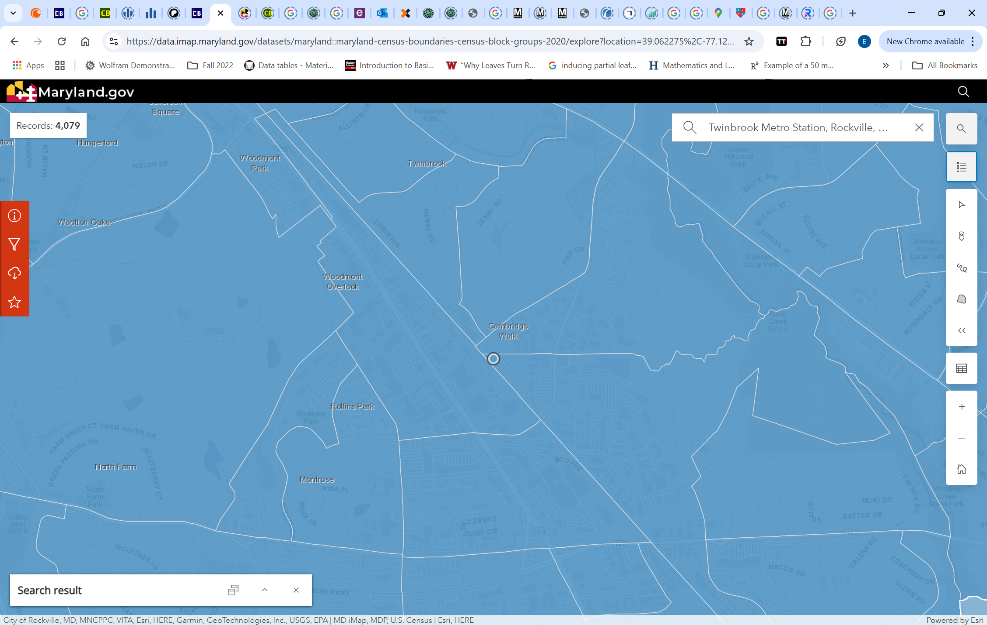
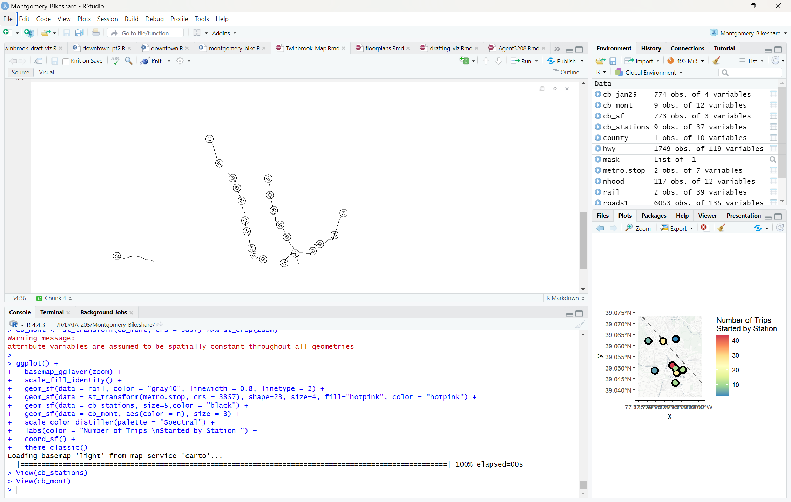
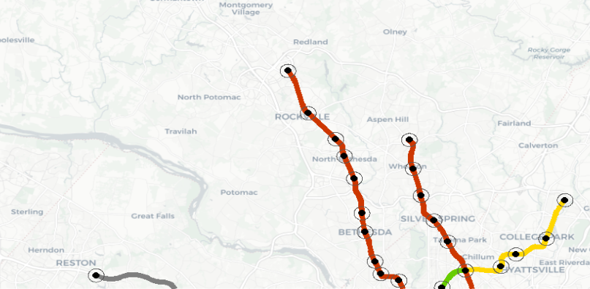
Capital Bikeshare and the American Community Survey
Capital Bikeshare
Each row represents a trip, for which there is a station ID, start/end coordinates, date-time, duration, and rider membership status.
Date Range from January 2010 to January 2025
American Community Survey
Tables of interest include variants of Means of Transportation to Work, and Residential Volume, with the geography grain at the census block group level.
Focal date range begins at no earlier than 2019, due to the changes resulting from the COVID-19 pandemic.
Level of Traffic Stress Survey
Conducted by the Montgomery County Planning Department in 2021.

Slide 4
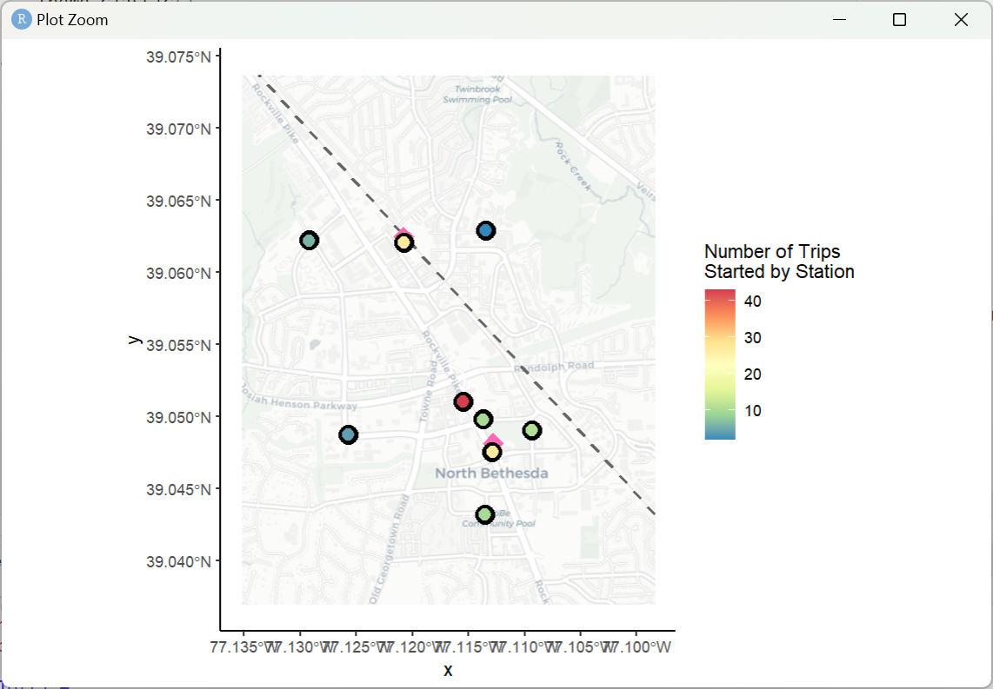
Research Goals
Rockville’s city planners are interested in understanding how micromobility trends may develop locally.
How can trips be characterized?
Is there seasonal variation in the frequency of trips?
Does the duration or seasonality of trips vary with membership status?
Does the distribution of trip start times vary based on the bike's starting location?
What are the circumstances of trips destined for the area around a metro station?
Does the transit development area around the metro station serve the residents that live there? For Twinbrook? North Bethesda?
Does trip frequency differ by proximity to / availability of biking infrastructure?
Has ridership increased over the years?

Slide 5
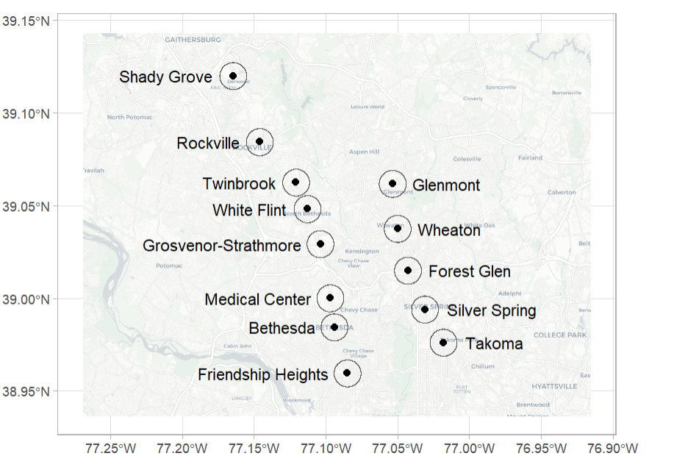
Methods
Clustering stations by location and characterizing trips to compare trends of micromobility around Twinbrook Metro Station to that around North Bethesda Metro Station (formerly known as White Flint)
Clustering trips based on their proximity to a metro station (half-mile radius)
Using trip data to investigate the ways bikeshare is being utilized in different areas by residents and visitors
Report on the commuting habits of the local community to assess whether the people that live there reap the benefits of the transportation developments in the area

Slide 6
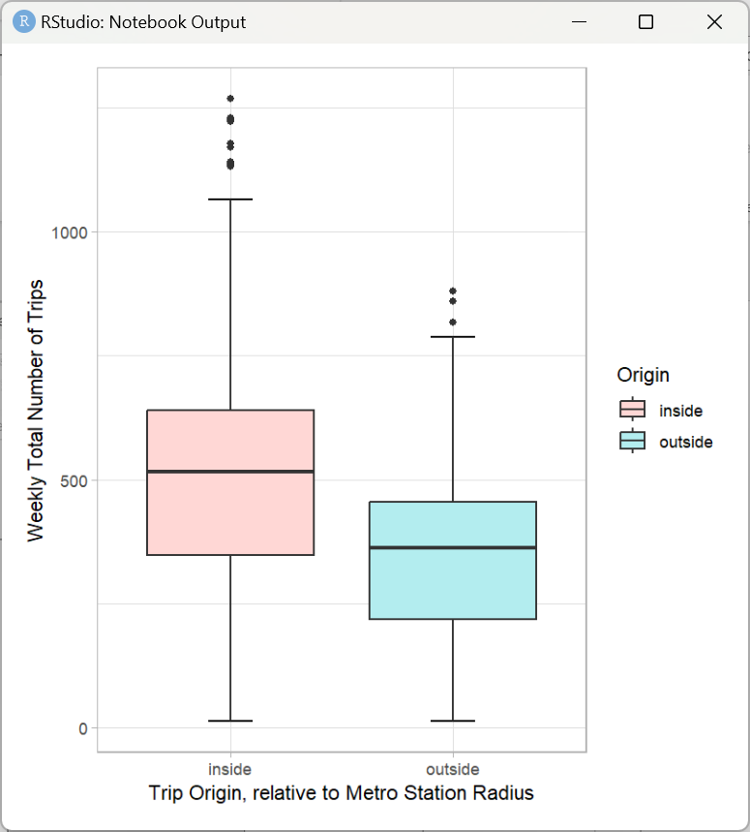
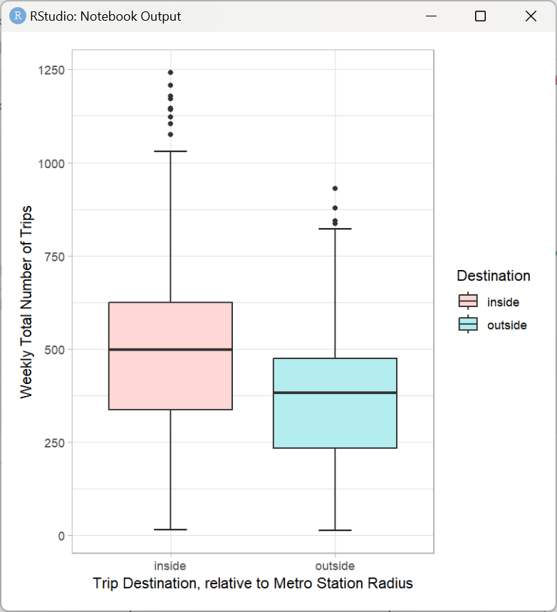
Number of Trips by Proximity to Metro
Rejected Null Hypotheses:
The weekly average number of trips is the same for trips started near and far from a metro station.
The weekly average number of trips is the same for trips destined near and far from a metro station.
t = 7.3404, df = 468.71, p-value = 9.477e-13
t = 8.8404, df = 458.34, p-value < 2.2e-16

Slide 7
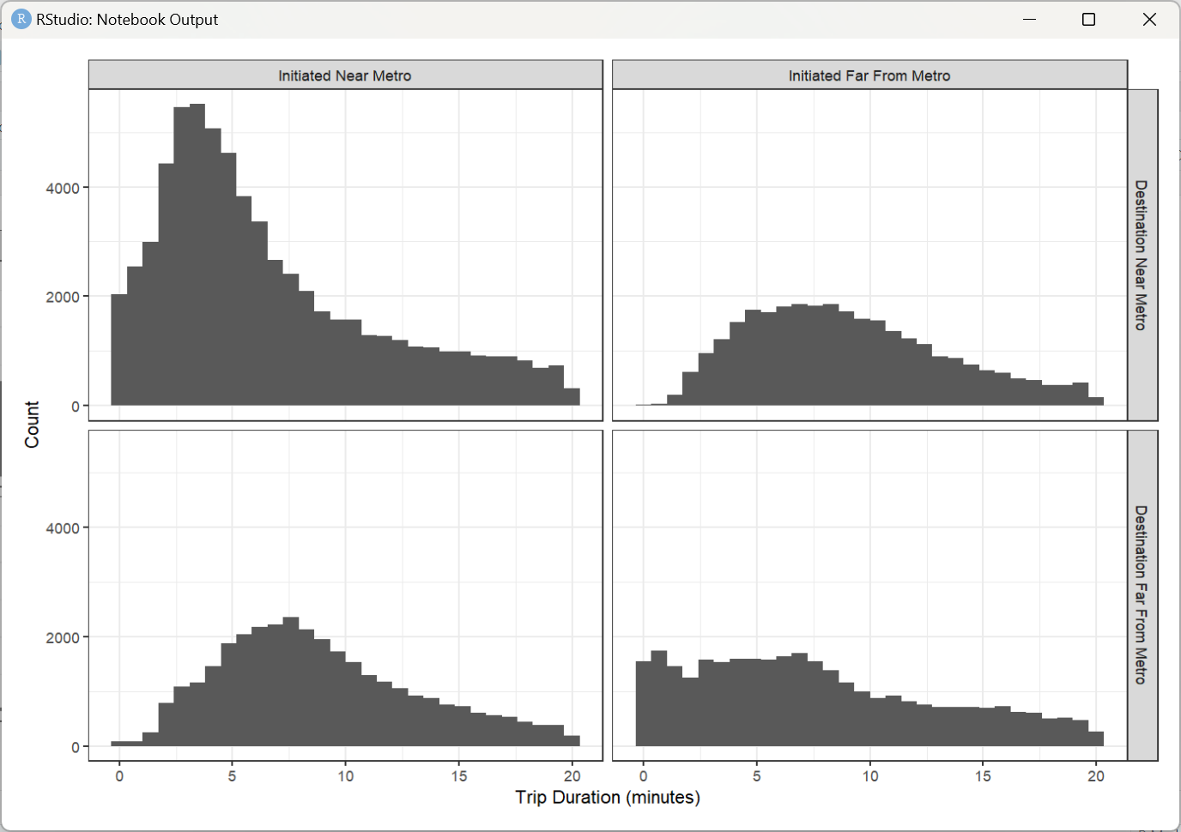
Trip Duration by Origin and Destination, relative to a metro station

Slide 8
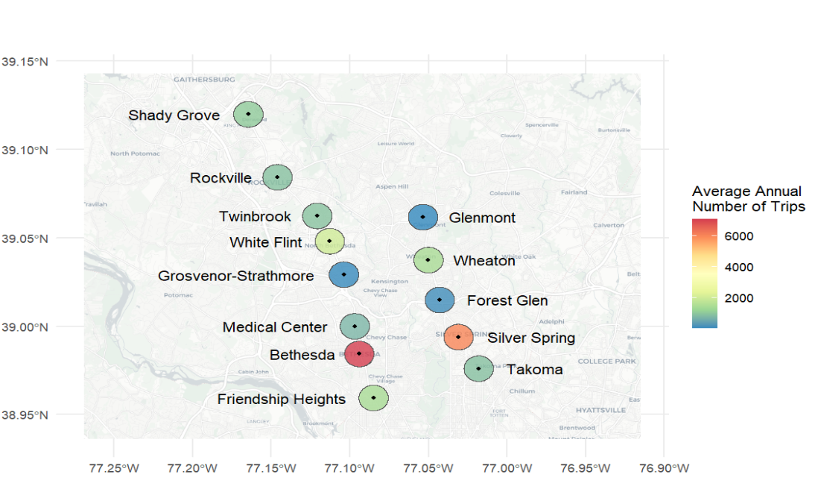

Slide 9
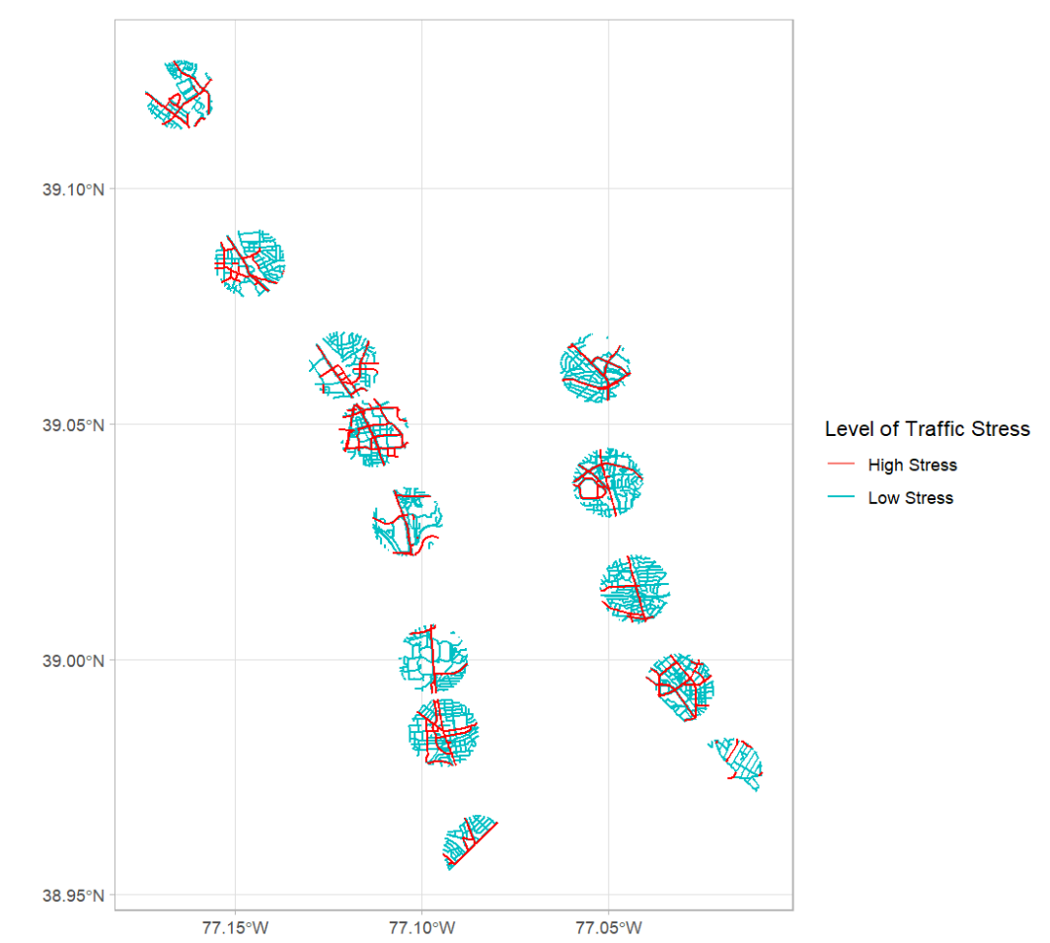
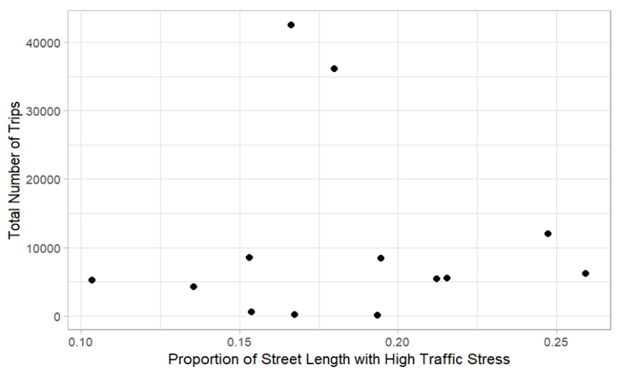
t = -0.0347, p = 0.973

Slide 10
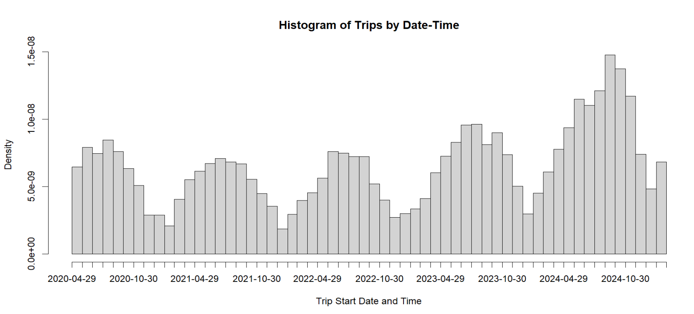

Slide 11
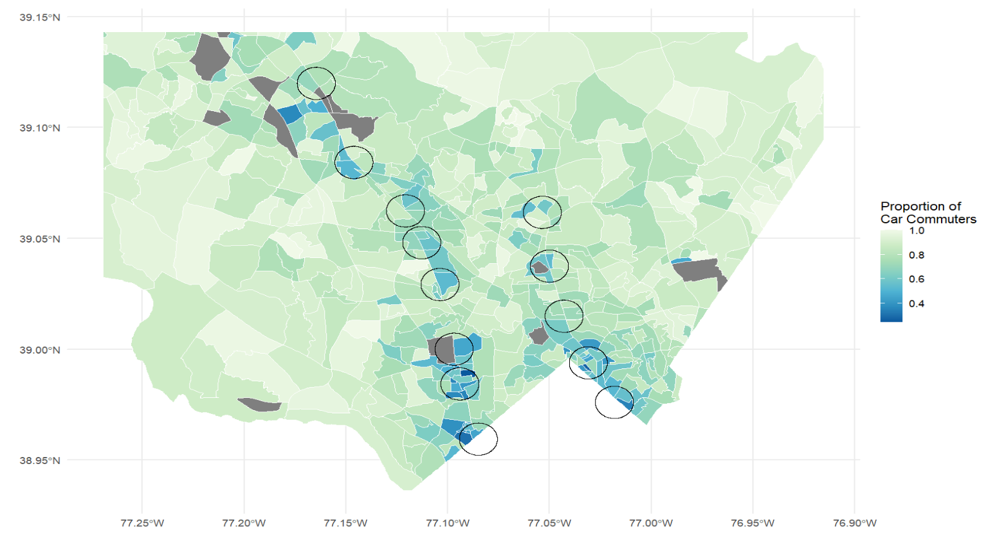

Slide 12
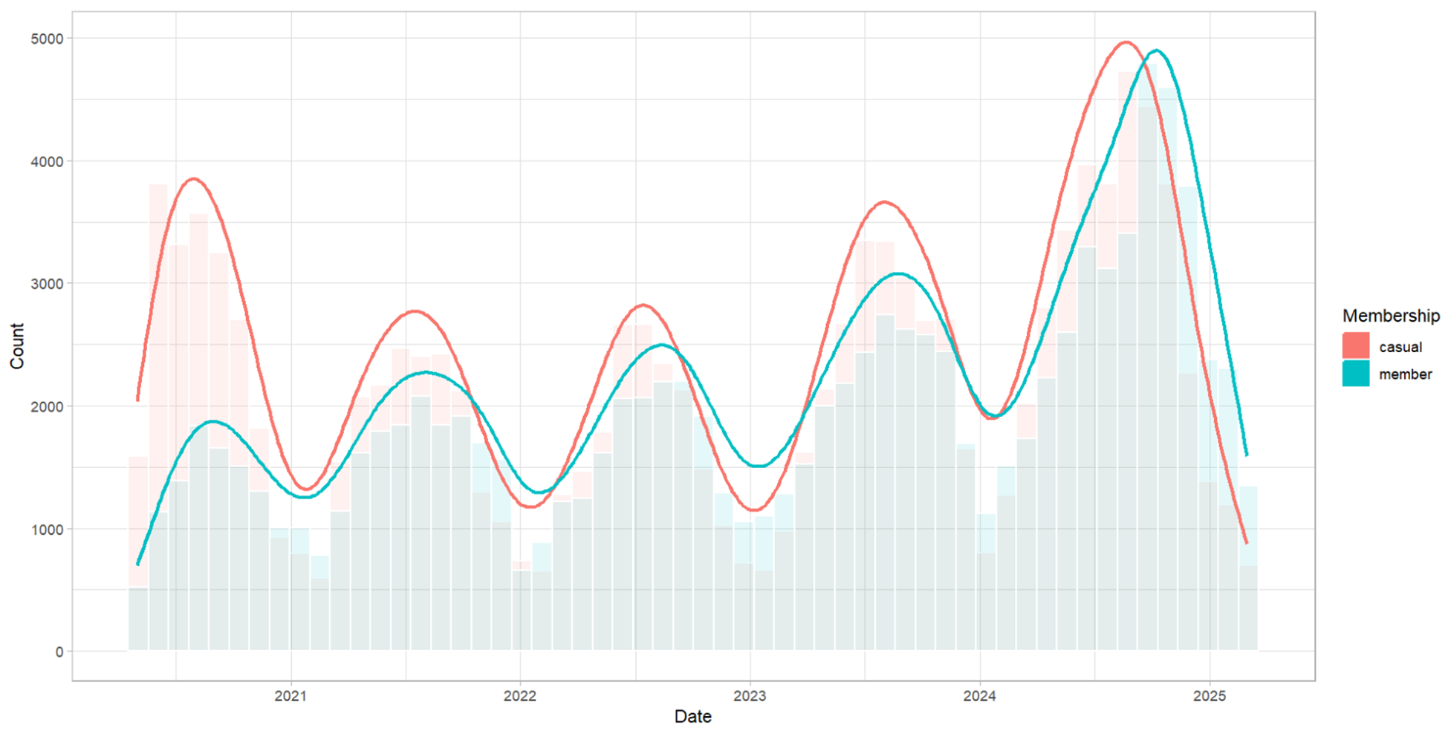
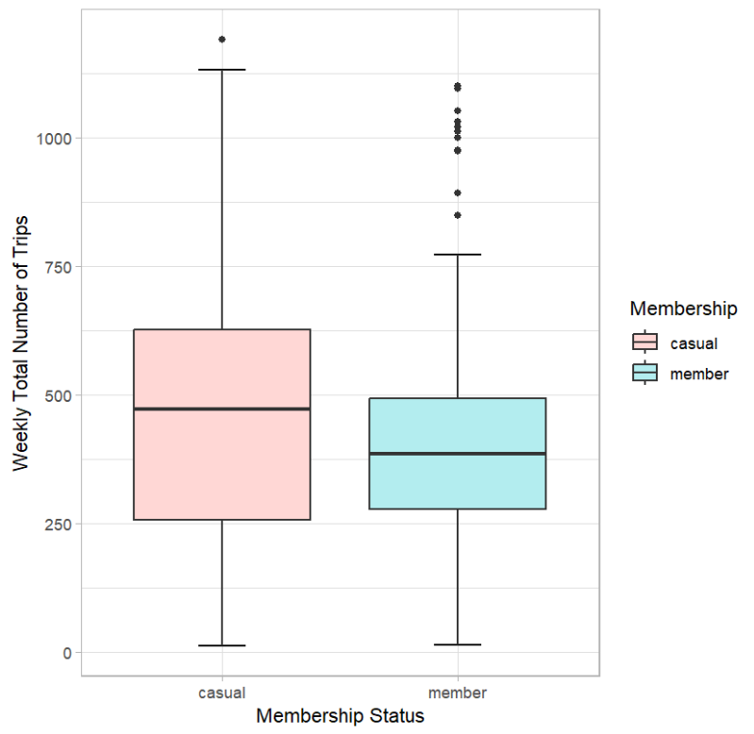
Total Number of Trips by Membership
t = 2.6453, df = 490.8, p-value = 0.008423

Slide 13
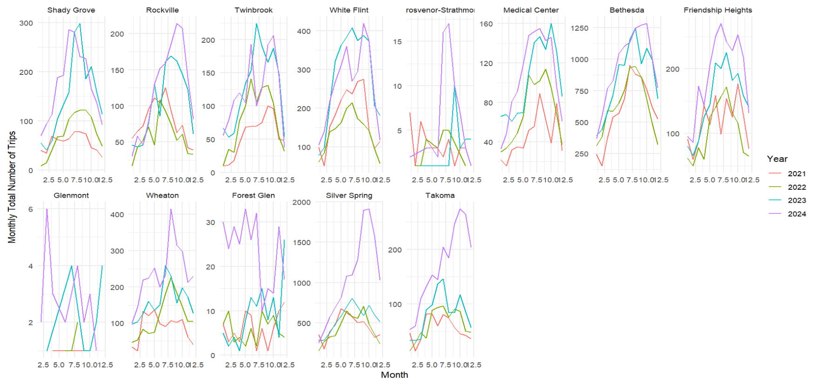
Monthly Total Number of Trips

Slide 14
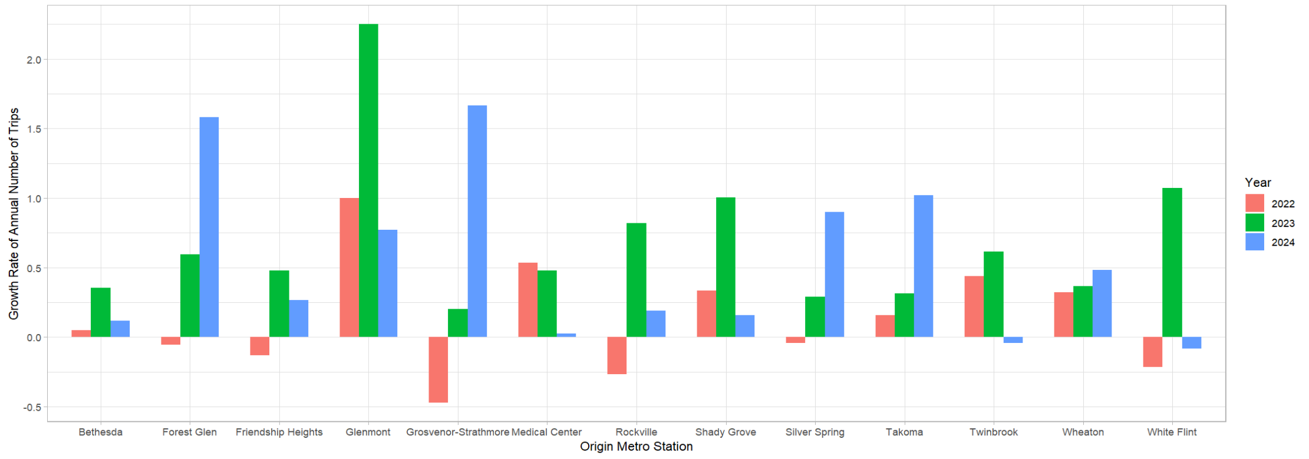
Growth Rate of Annual Average Number of Trips

Slide 15
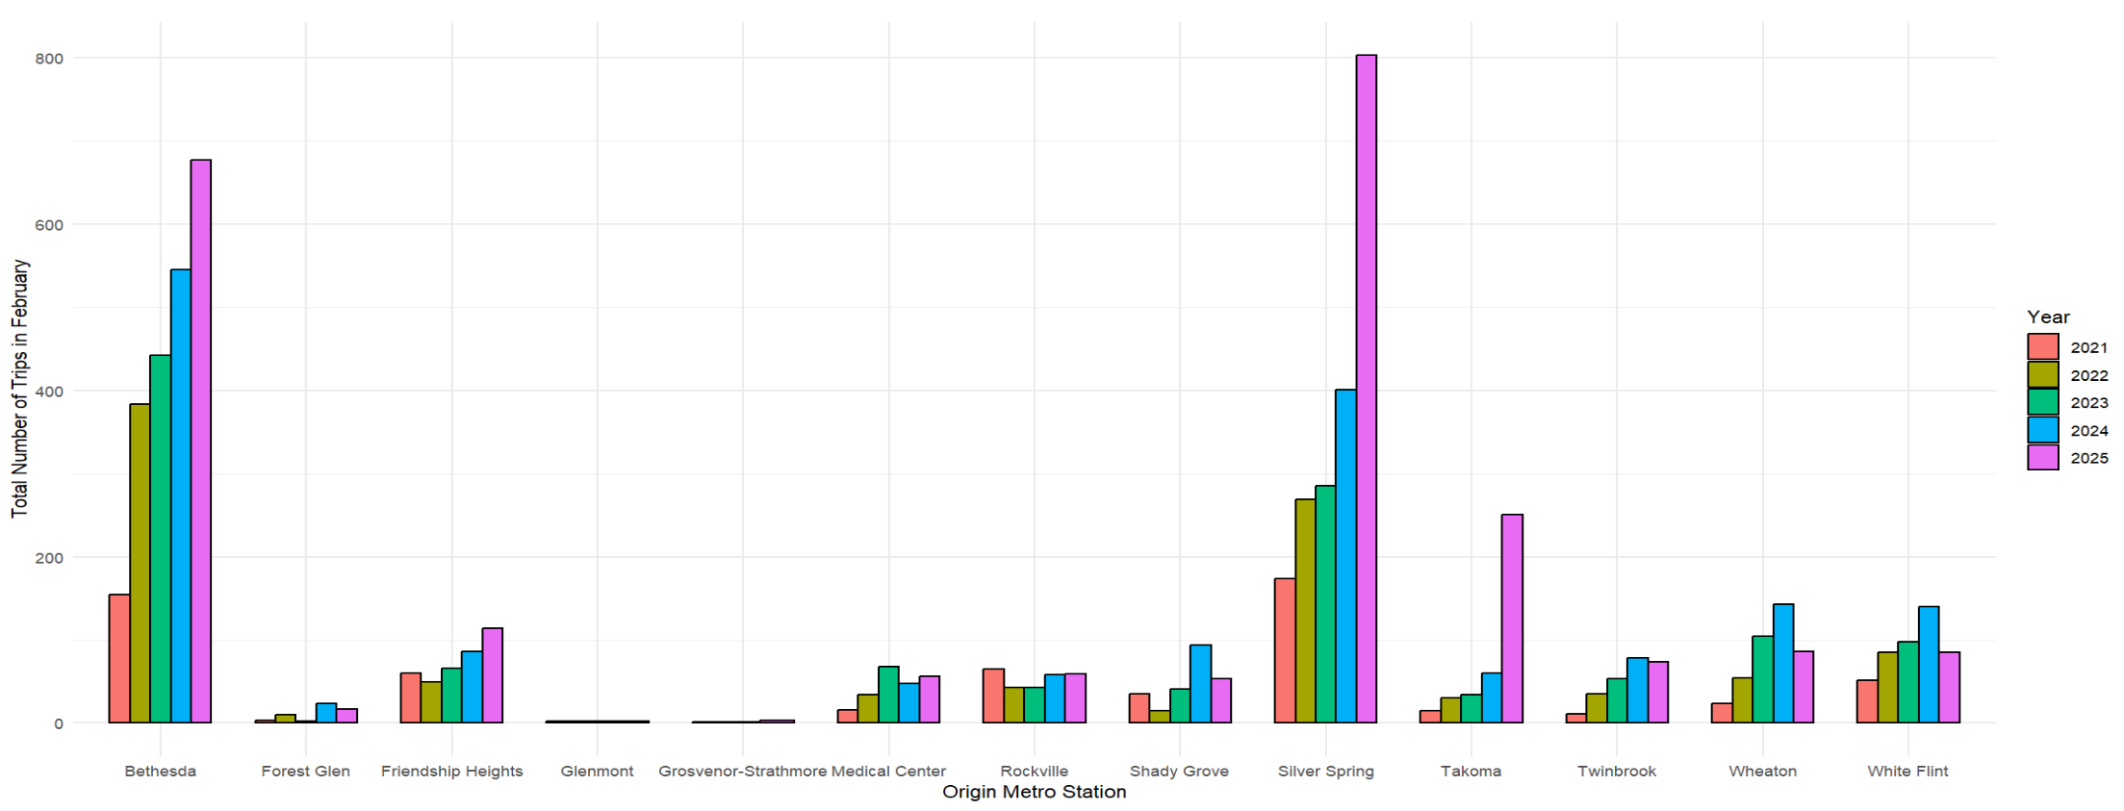
Total Number of Trips in February

Slide 16
Acknowledgements
Prof. Perine and Prof. Saidi, Data Dept. at Montgomery College
Abe Bruckman and Manisha Tewari, Rockville City Planning Dept.
Thank you for your support!

Slide 17
Sources
https://www.montgomeryplanning.org/transportation/bikeways/bicycle_demand_map.shtm#trough_trip_demand
https://montgomeryplanning.org/planning/master-plan-list/general-plans/thrive-montgomery-2050/thrive-montgomery-2050-top-issues/
https://montgomeryplanning.org/tools/gis-and-mapping/data-downloads/
https://www.alexandriava.gov/sites/default/files/2023-11/Capital%20Bikeshare%20FY24%20Work%20Plan.pdf
https://www.alexandriava.gov/performance-analytics/department-of-transportation-and-environmental-services-tes-capital-bikeshare
https://ggwash.org/view/73036/transit-walksheds-show-how-far-can-you-get-in-a-ten-minute-walk-from-metro
https://ggwash.org/view/92292/bikeshare-beat-cabi-wraps-up-a-year-of-historic-ridership-in-december
https://ggwash.org/view/98229/bikeshare-beat-capital-bikeshare-records-over-6.1-million-rides-in-2024-fastest-growing-system-in-us
https://www.bts.gov/data-spotlight/docked-bikeshare-ridership-increase-2023-most-not-all-systems
https://www.npr.org/transcripts/1239552997
https://data.imap.maryland.gov/
https://data.imap.maryland.gov/datasets/maryland::maryland-census-boundaries-census-block-groups-2020/about
https://censusreporter.org/tables/B08301/
https://www.transportation.gov/sites/dot.gov/files/2024-10/RAISE%202025%20NOFO_%20Signed.pdf
https://www.montgomerycountymd.gov/DOT-DIR/commuter/bikesharingCSS.html
https://www.mdot.maryland.gov/OPCP/MBPAC_WalkshedPresentation_10.23.2020.pdf
https://www.wmata.com/business/real-estate/upload/Station-Area-Planning-Guide-October-2017.pdf
https://planning.maryland.gov/Documents/Our-Engagement/773/2019/2019-0325-transit-station-area-profile-tool.pdf
https://www.mcatlas.org/bikestress/
https://www.mcatlas.org/bikestress/documentation/ModifiedLevelOfTrafficStressMethodology.pdf

